Slide 1

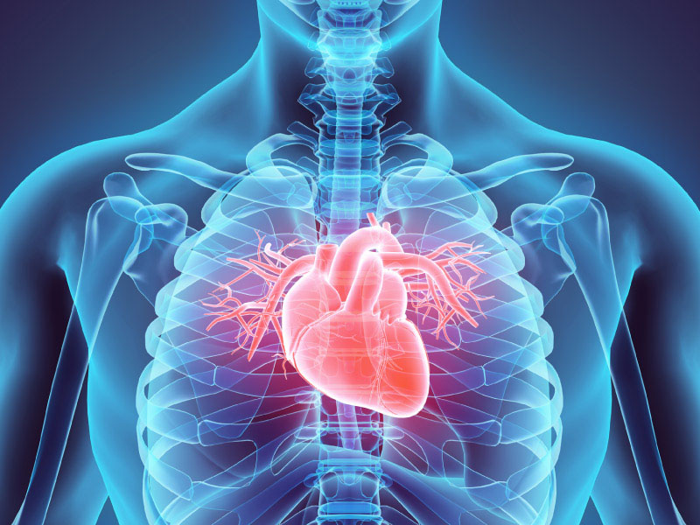
ITCS227 Introduction to Data Science
Heart Disease Prediction
6688011 Kittipob Bumphen
6688018 Nonthapath Chaworanum
6688027 Yuhan Huang
6688113 Duangwang Srisa-ard
6688232 Xinyi Chen

Slide 2


Introduction
Methodology
Result
Future Work
CONTENTS

Slide 3
01
Introduction

Slide 4

1.1. Global Impact of Heart Disease
ref: Cardiovascular diseases (CVDs)
Cardiovascular diseases (CVDs) are the leading cause of death globally.
An estimated 17.9 million people died from CVDs in 2019, representing 32% of all global deaths. Of these deaths, 85% were due to heart attack and stroke.
Over three quarters of CVD deaths take place in low- and middle-income countries.
Out of the 17 million premature deaths (under the age of 70) due to noncommunicable diseases in 2019, 38% were caused by CVDs.
Most cardiovascular diseases can be prevented by addressing behavioural and environmental risk factors such as tobacco use, unhealthy diet and obesity, physical inactivity, harmful use of alcohol and air pollution.
It is important to detect cardiovascular disease as early as possible so that management with counselling and medicines can begin.

Slide 5
1.2. Role of Machine Learning
Early Detection & Risk Assessment
Machine learning models analyze medical data to detect early signs of heart disease.
Predicts a patient’s risk based on historical health records, allowing early intervention.
Reducing Healthcare Costs
Early detection reduces hospitalization rates and treatment costs.
Automates routine diagnostic tasks, saving time for healthcare professionals.
01
02

Slide 6
1.3. Project Objectives
Use data science skills to analyze reasons for heart disease
Build a model for prediction

Slide 7

02
Methodology

Slide 8



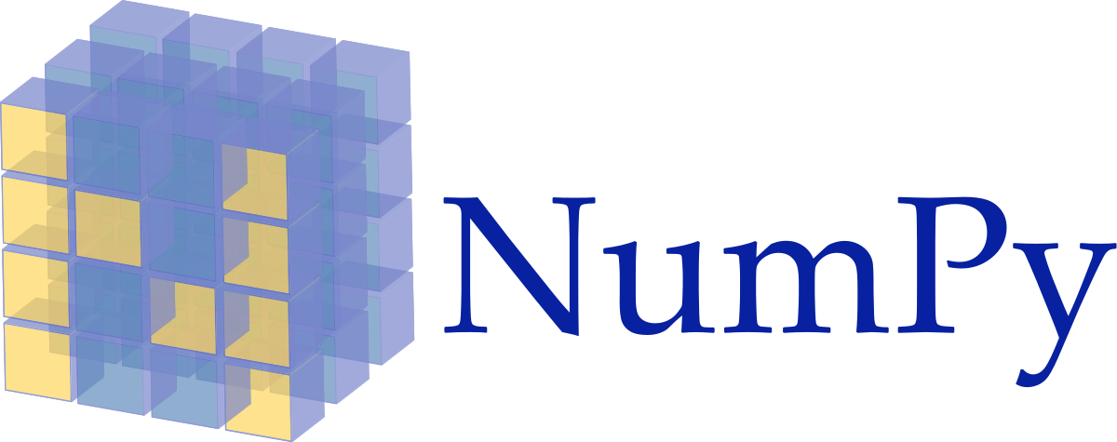





2.1. Develop Environment and Tools
Develop Environment
VScode
Ubuntu 22.04 (wsl)
Python 3.X
Tools
Numpy
Seaborn
Pandas
Matplotlib
Scipy
Sklearn

Slide 9
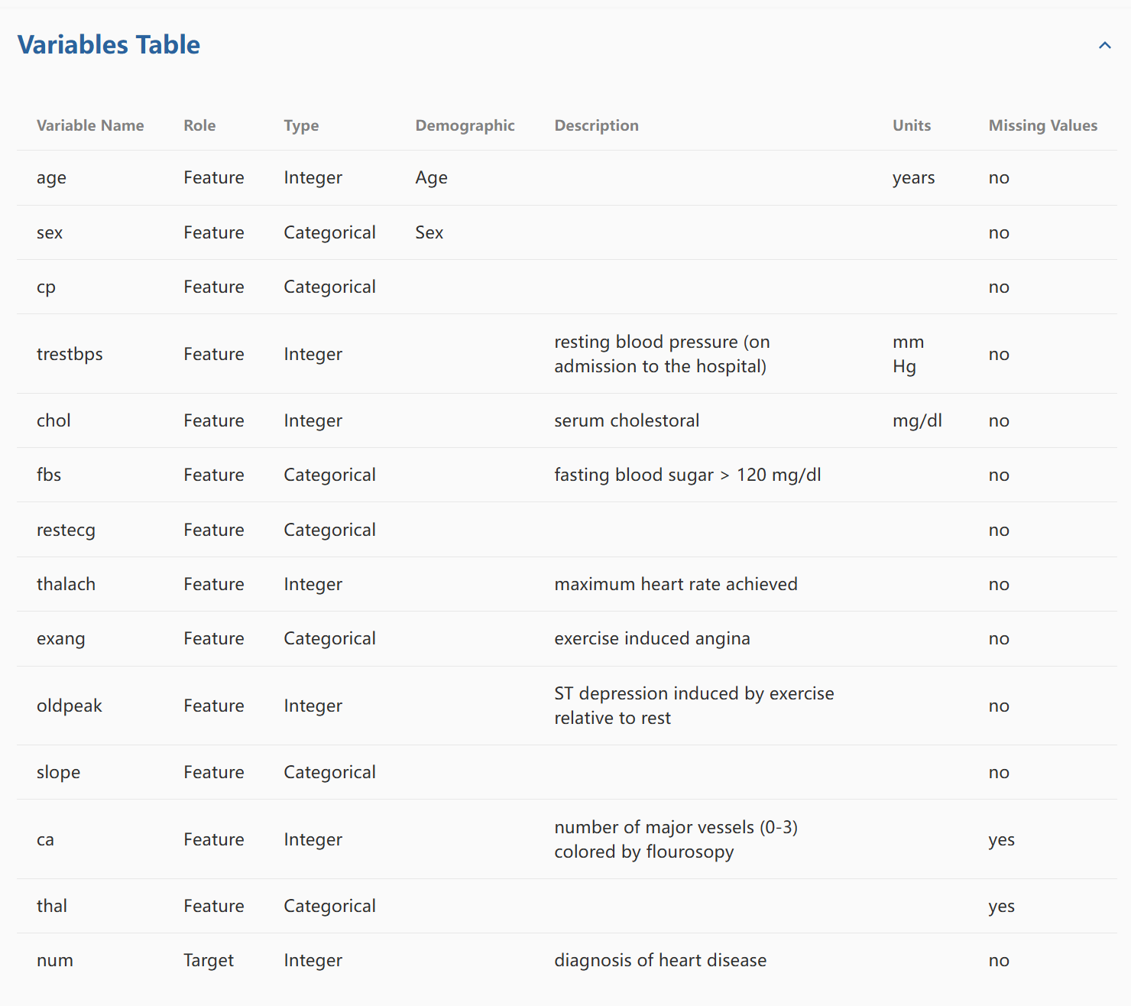
2.2. Data acquisition
Data source: Heart Disease - UCI Machine Learning Repository
Data Information: The Cleveland database contains 76 attributes, but only 14 are used in experiments, mainly for distinguishing the presence (values 1-4) or absence (value 0) of heart disease. The database has had patient names and social security numbers replaced with dummy values.
Dataset size: 59.2 KB
Use the UCI Heart Disease Dataset, which includes patient demographics and medical history.

Slide 10
2.3. Data Preprocessing
1. Handeling Missing Value
‘ca’: 1.32% missing
‘thal’: 0.66% missing
Dropped missing entries via dropna() (low impact).
2. Data Type Conversion
Target Variables: ‘ca’ and ‘thal’ → converted to float
Ensure numerical computation compatibility.
Meet ML algorithm requirements.

Slide 11
2.4. Understanding Data and Normalization
Target Variable Conversion (Binary Transformation)
Original multi-class labels → Merged into:
0: No heart disease
1: Presence of heart disease
Ensures compatibility with binary classifiers (e.g., Logistic Regression).

Slide 12
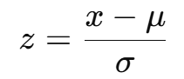
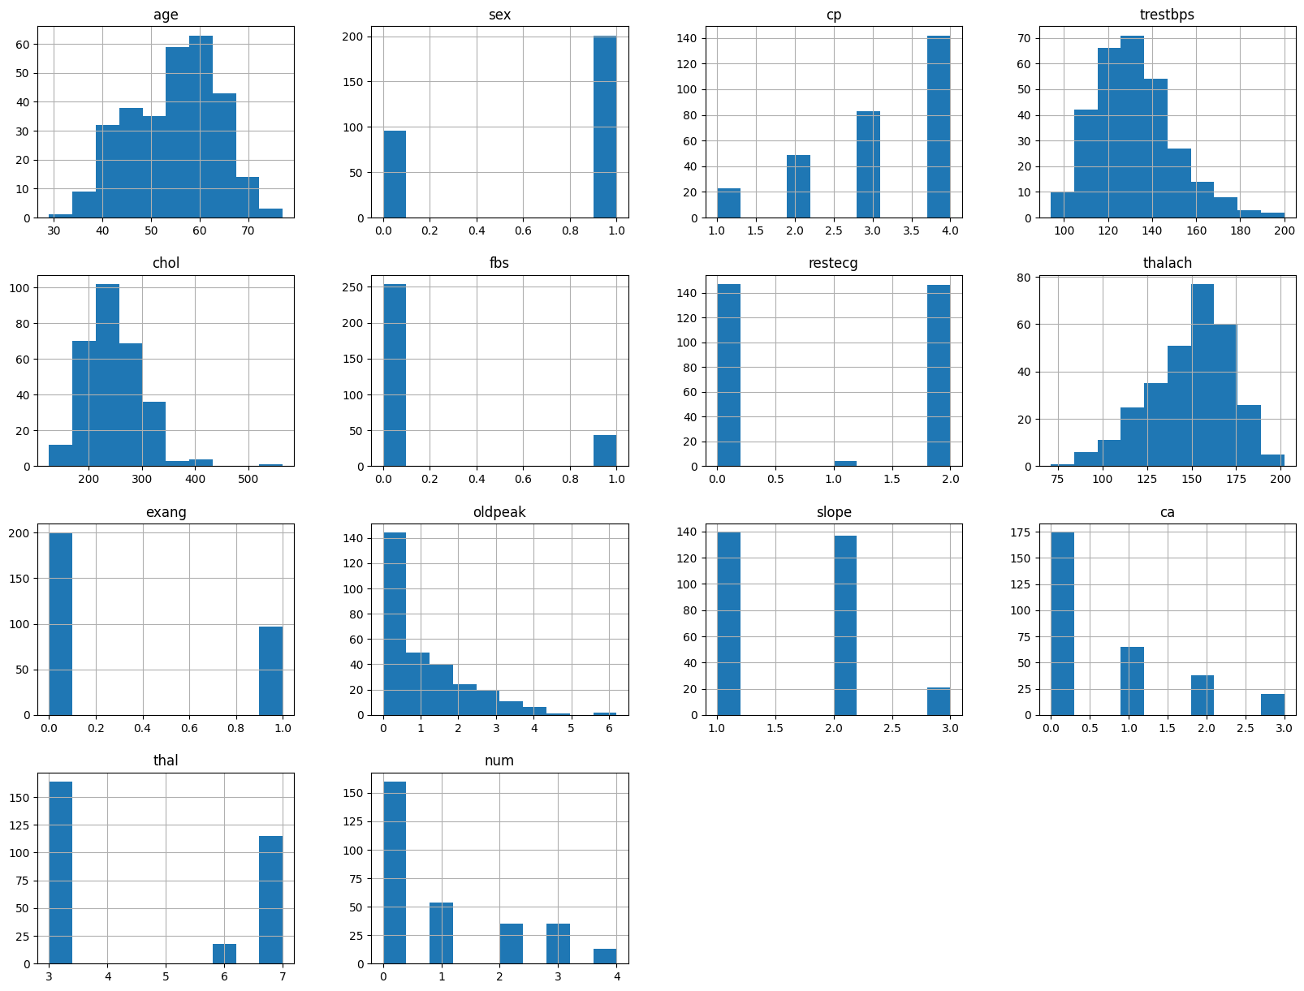
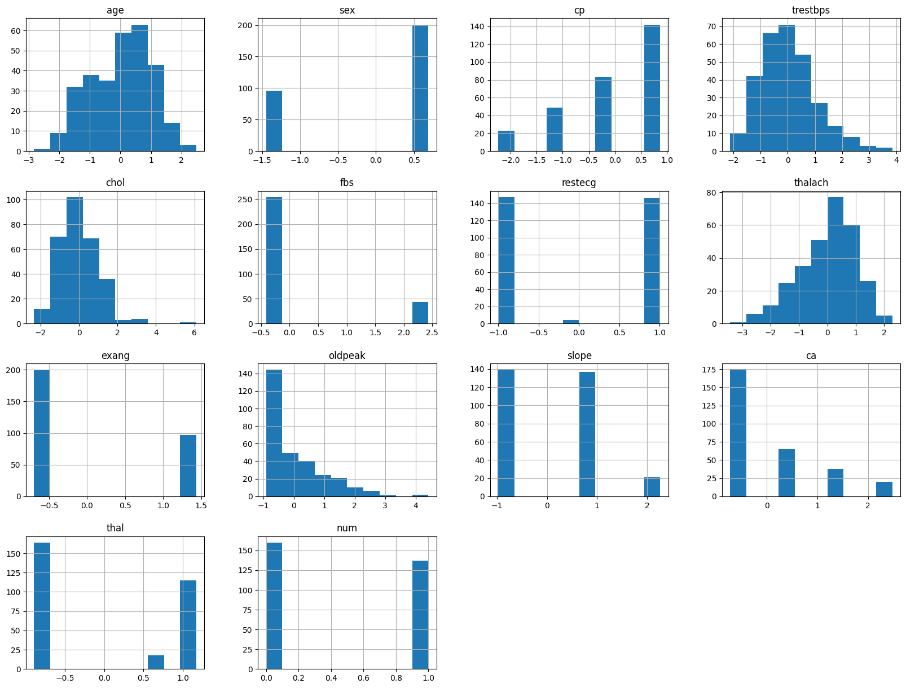
2.4. Understanding Data and Normalization
Feature Normalization (Standard Scaler)
Equalizes feature influence.
Accelerates gradient-based convergence.
before
after

Slide 13
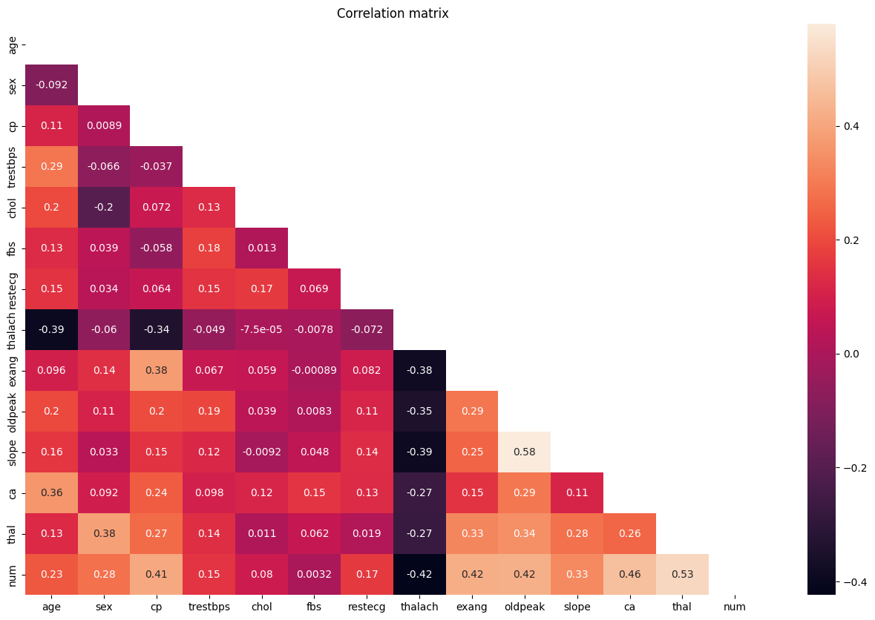
2.4. Understanding Data and Normalization
Correlation Analysis
Key Clinical Features

Slide 14
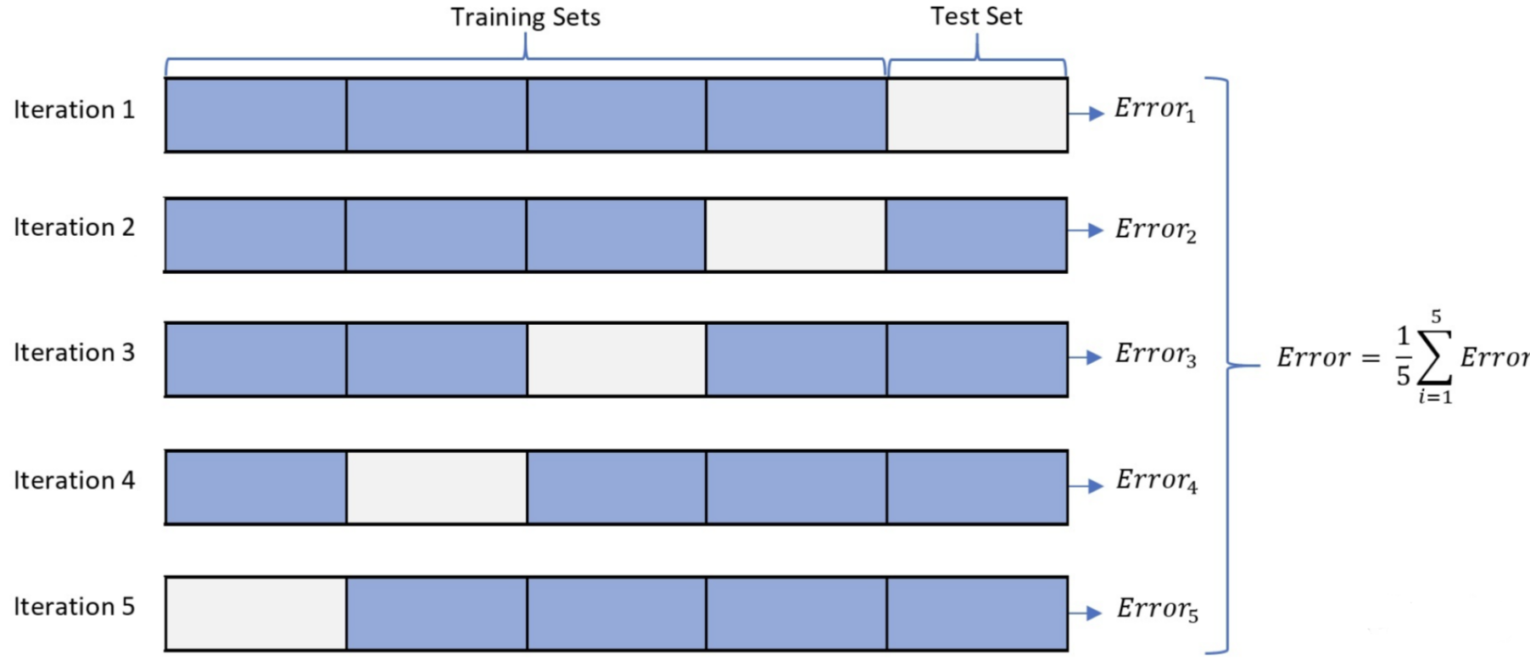
2.4. Understanding Data and Normalization
Train Test Split
Train (80%) | Test (20%)
Training Set: Model training and cross-validation (5-Fold)
Independent Test Set: Final model evaluation

Slide 15
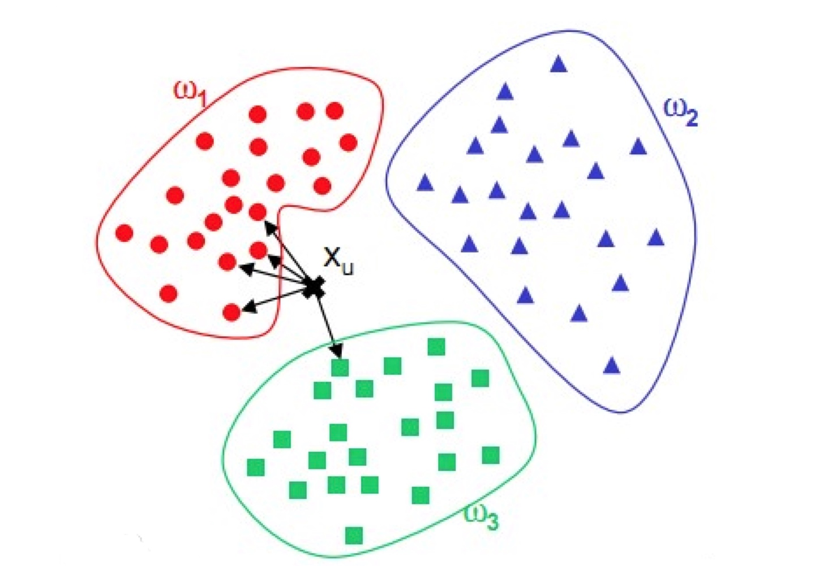
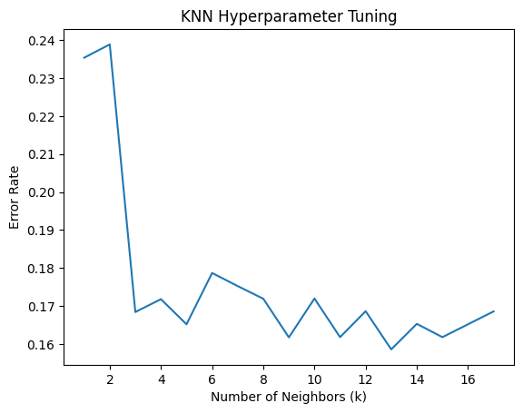
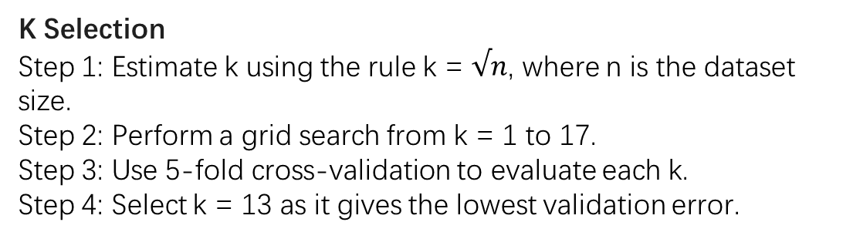
2.5. Modeling
2.5.1 KNN
K Selection
Step 1: Estimate k using the rule k = $√n$, where n is the dataset size.
Step 2: Perform a grid search from k = 1 to 17.
Step 3: Use 5-fold cross-validation to evaluate each k.
Step 4: Select k = 13 as it gives the lowest validation error.
The k-nearest neighbors (KNN) algorithm is a non-parametric, supervised learning classifier, which uses proximity to make classifications or predictions about the grouping of an individual data point.

Slide 16
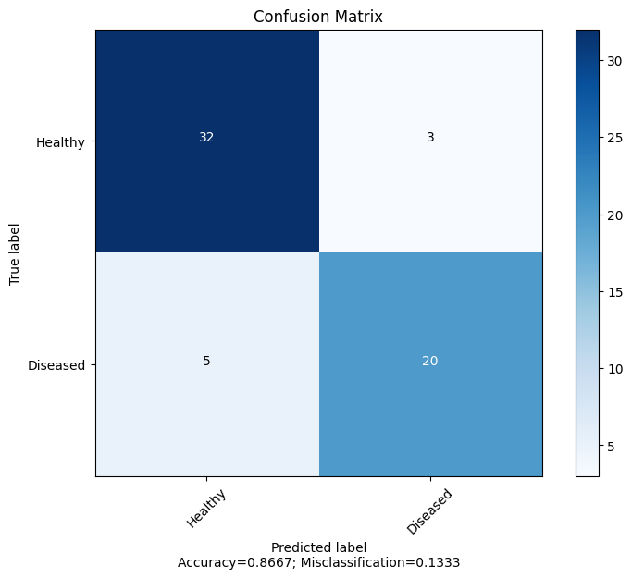
2.5. Modeling
2.5.1 KNN
result
Metric | Value
Accuracy | 0.8667
Precision | 0.8696
Recall | 0.8000
F1 | 0.8333

Slide 17
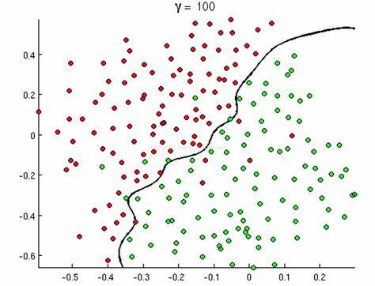
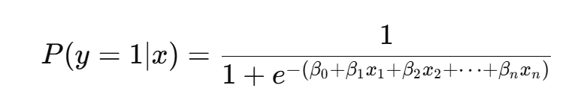
2.5 Modeling
2.5.2 Logistic Regression
Step1: Maps a linear combination of features to the (0,1) interval using the Sigmoid function:
Step2: Cross Validate (5-Fold)
Logistic regression is a supervised machine learning algorithm widely used for binary classification tasks

Slide 18

2.5. Modeling
2.5.1 Logistic Regression
result
Metric | Value
Average Accuracy | 0.9000
Average Precision | 0.9130
Average Recall | 0.8400
Average F1 | 0.8750

Slide 19
03
Result

Slide 20
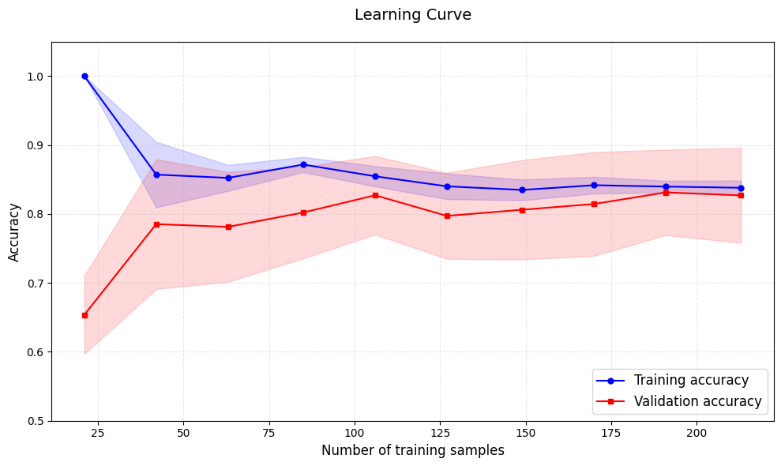
3. Modeling
Comparison
Metric | KNN | Logistic Regression
Accuracy | 0.8667 | 0.9000
Precision | 0.8696 | 0.9130
Recall | 0.8000 | 0.8400
F1 Score | 0.8333 | 0.8750
Learning Curve for Logistic Regression
Logistic Regression is better

Slide 21

04
Future Works

Slide 22
4. Future Works
Limitations
The dataset is mainly composed of patients from Western populations. Limited generalizability to other ethnic groups (e.g., Thai population)
These models are based on traditional machine learning algorithms, insufficient when dealing with complex time-series data.
Future Works
Apply transfer learning or data augmentation using local patient data, enhance model fairness and adaptability to diverse populations.
Deep Learning Integration: Explore Transformer-based architectures for sequential data.

Slide 23
Thanks

Slide 24
Q & A

